Slide 1
Mini Project
Automated soldering machine
MENTOR :
ASHIQ RAHMAN ANWAR BATCHA
MEMBERS:
VASANTH KUMAR V
GIRINATH R
KASI VISWANATHAN S
KARTHIKEYAN N

Slide 2
Agenda
Abstract – Karthikeyan N
Flow of work – Vasanth Kumar
GUI application – Girinath R
Working – Kasi
Cases it will pass and fail – Karthikeyan N
Scope for Future Work – Girinath R

Slide 3
Abstract:
We ECE students spend a lot of time in soldering ICs and other electronic components which is a very trivial task when compared to designing and testing. It would be awesome if we have a machine that does the soldering process after we design. The objective of our project is to build a Computer Controlled Soldering Machine that can solder Through Hole components placed on a PCB. It takes the co-ordinates of soldering points from a file generated by EDA software (Eagle/Altium) which are processed and fed to a micro-controller based device. This in turn controls the actuators and get our work done. This prototype would save a lot of circuit-building time.

Slide 4
FLOW OF WORK

Slide 5
Launching the SOLDER app
5
Generating CSV file
Extracting soldering points from CSV
Design
PCB file
The app interface allows batch of soldering boards
All holes soldered
Calculating steps needed to traverse from one point to another using Python
ESP32 receives the command and controls the actuators
The calculated results are wirelessly sent to ESP32

Slide 6
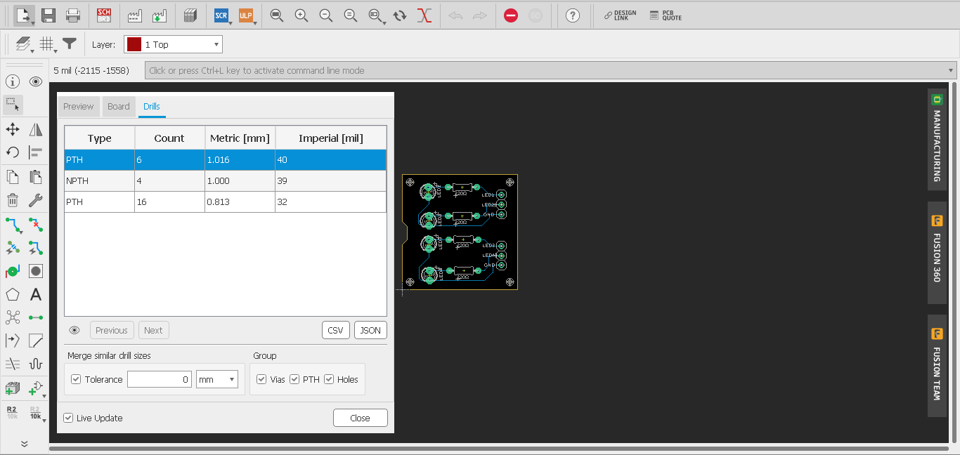
6
GENERATING CSV FILE FROM EAGLE

Slide 7
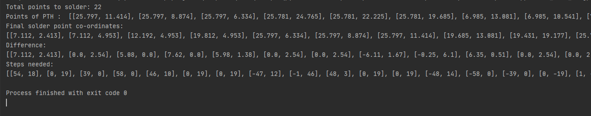
7
SOFTWARE OUTPUTS:

